Slide 1
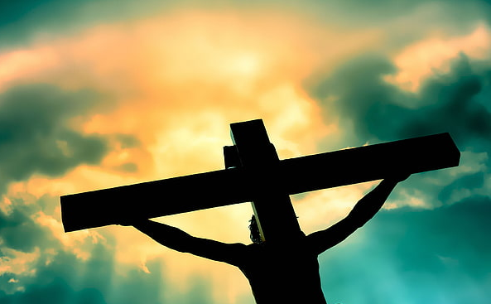
“It is Finished”
John 19:30
Notes:
When Jesus died on the cross, He finished all that God had given Him to do and all that was foretold by the Scriptures. His sacrifice accomplished paying the price for our redemption. And His death “finished” (fulfilled, was the end point) of the Law of Moses. The battle with Satan was all but finished as well.

Slide 2
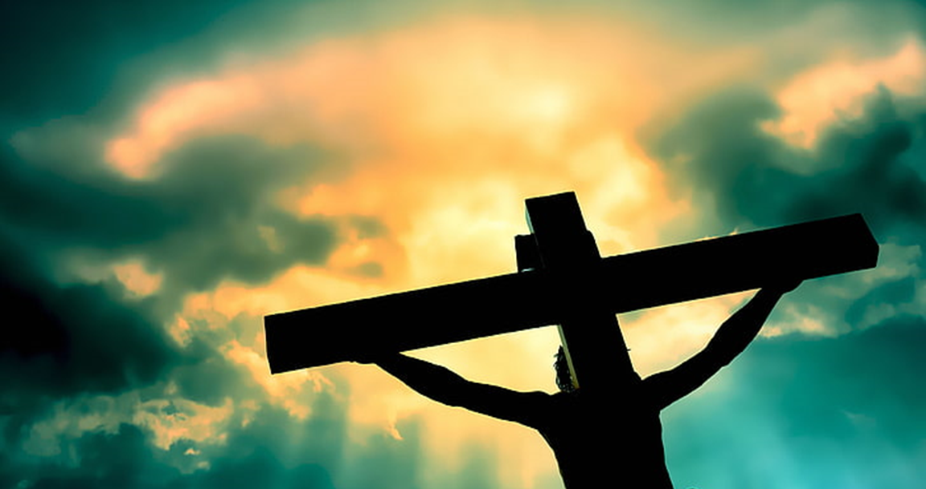
The meaning of “Finished”
Definitions of the Word translated “Finished” (Thayer’s Greek Lexicon).
to bring to a close, to finish, to end
to perform, execute, complete, fulfil
to do just as commanded, and generally involving the notion of time, to perform the last act which completes a process
to accomplish, fulfil
to pay

Slide 3
Jesus finished all that God had given him to do.
He knew that He had come to earth to accomplish God’s work (Jn. 4:34; Lk. 12:50).
He knew the exact indignities He must endure to finish (Luke 18:31-33; 22:37).
He knew when it was finished (John 19:28).
In crucifying Jesus, the Jews “fulfilled all that was written concerning Him” (Acts 13:28-29).

Slide 4
His sacrifice finished paying the price for our redemption.
At the cross Jesus accomplished/finished providing cleansing for sin (Hebrews 1:3 ).
With His blood He obtained eternal redemption (Hebrews 9:11-12).
He put away sin by the sacrifice of Himself (Hebrews 9:25-28).

Slide 5
Jesus’ death “finished” the Law of Moses.
He fulfilled the righteous requirement of the Law (Romans 8:3-4).
He nailed the requirements of the Law to the cross (Colossians 2:13-14).

Slide 6
Jesus’ Death Accomplished Victory over the Forces of Evil
“Having disarmed principalities and powers, He made a public spectacle of them, triumphing over them in it” (Colossians 2:15)

Slide 7
Jesus Finished so that You Could Finish Too
We must run the race to receive our crown (1 Corinthians 9:24-27).
Paul was determined to finish with joy (Acts 20:24).
In the end he says, “I have fought the good fight, I have finished the race, I have kept the faith” (2 Timothy 4:7).

